Slide 1

GCIS-124
Software Development & Problem Solving
14: Semester Review

Slide 2
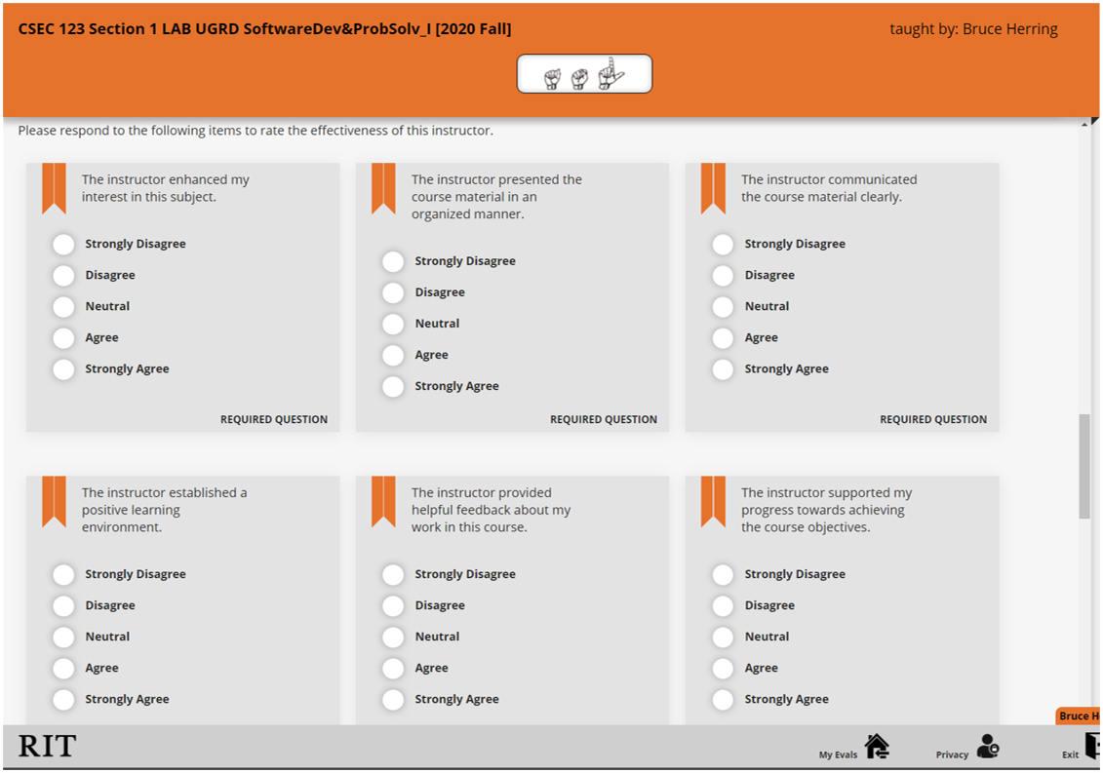
Course Evaluations
Each semester you are given an opportunity to evaluate the courses you are taking​
This is your opportunity to provide feedback about the facilities, quality of instruction, etc.
Instructors and the college take the evaluations, especially the written portion, very seriously​
The comments you leave are seen by the instructor, department head, promotion committees, dean, and so on
We use it to help improve the course​
We can try to keep doing things that students liked
We can try to stop or change the things that students really didn't like
This is doubly important for new course offerings such as this one​
Last semester's evals inspired changes like introducing the "practice practical problem" assignments on Mondays
Your instructor will not be able to see any evals until 2 days after final grades are submitted.
Even then, the evals remain totally anonymous
If you have not already, please take a few minutes to fill out the evaluation for this course.

Slide 3

Exam Format
The final exam will consist of two equally weighted parts:
A "written" portion (40%) delivered as a MyCourses quiz
A practicum portion (60%) using GitHub Classroom
You will have a total of 2.5 hours to finish both portions of the exam.
You will be required to start the written portion within the first 10 minutes of class
Once you begin, you will be able to spend your time as you see fit
It is strongly recommended that you do the written portion first as it is easy to lose time during the practicum portion
The exam will be comprehensive, but there is likely to be more emphasis on recent material
Neither part of the exam is written yet
We do not yet know how many questions, what type of questions, etc.
Your instructor will discuss any section specifics with you before the exam
The final exam is per SIS calendar for your section.
If you have been afforded and plan to use extended time accommodations, it is your responsibility to notify your instructor before the exam date.

Slide 4
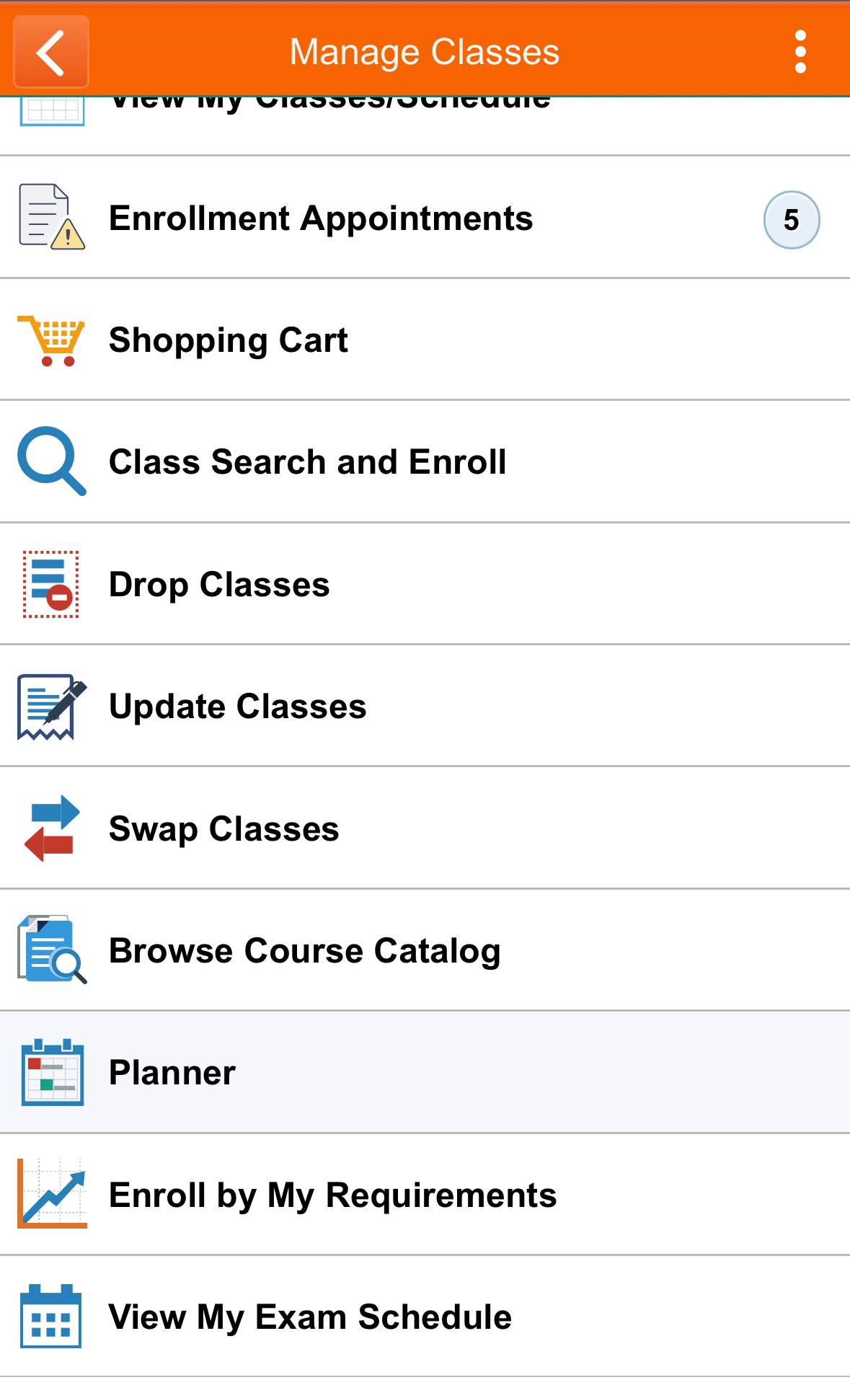
13.0
Final Exam Conflicts
If you have a final exam conflict, you will need to schedule a make up exam at a different time during finals week. Check your final exam schedule now!
A Final Exam Conflict is one of the following:
Two exams at the same time.
Three or more exams on the same day.
Log into SIS and check your final exam schedule.
Do you have another exam at the same time as your GCIS-124 final?
Do you have three or more exams on the same day as your GCIS-124 final?
If so, send an email with a screenshot of your final exam schedule to your instructor right away.
Travel plans do not constitute a final exam conflict. Do not make travel plans during your finals!

Slide 5


Slide 6
Threads | Graphs | Greedy Algorithms | Backtracking | Potpourri
100 | 100 | 100 | 100 | 100
200 | 200 | 200 | 200 | 200
300 | 300 | 300 | 300 | 300
400 | 400 | 400 | 400 | 400
500 | 500 | 500 | 500 | 500

Slide 7
Threads | Graphs | Greedy Algorithms | Backtracking | Potpourri
200 | 200 | 200 | 200 | 200
400 | 400 | 400 | 400 | 400
600 | 600 | 600 | 600 | 600
800 | 800 | 800 | 800 | 800
1000 | 1000 | 1000 | 1000 | 1000

Slide 8

Jumble Word Backtracking Solver
Download http://holly.cs.rit.edu:20001/Jumble.zip
Implement the following:
getSuccessors
isValid
isGoal
Additional instructions in the zip file
Notes:
Have teams place wagers at this point.

Slide 9

@Override
public Collection<JumbleSolver> getSuccessors() {
List<JumbleSolver> successors = new ArrayList<>();
for (Character c : remainingLetters) {
List<Character> remainingLettersCopy = new ArrayList<>(remainingLetters);
remainingLettersCopy.remove(c);
successors.add(new JumbleSolver(word + c, remainingLettersCopy));
}
return successors;
}
@Override
public boolean isValid() {
return DICTIONARY.isPrefix(word);
}
@Override
public boolean isGoal() {
return remainingLetters.isEmpty() && DICTIONARY.isWord(word);
}

Slide 10
This interface lets a class define work for a thread without using inheritance.
What is Runnable?

Slide 11
This method pauses the current thread for a specified amount of time.
What is Thread.sleep()?

Slide 12
This Java abstraction manages a pool of threads and runs tasks without creating threads manually.
What is ExecutorService?

Slide 13
This is used to release waiting threads all at once.
What is CountDownLatch?

Slide 14
CODING CHALLENGE!
Create a new Java class name Sleeper with an initializing constructor for number of seconds.
Make it a thread using your preferred method.
When executing, it should print a message before and after sleeping the given number of seconds.
In main, start 5 threads with a random sleep interval of 1-10 seconds.

Slide 15
public class Sleeper implements Runnable {
private int sleepTime;
public Sleeper(int sleepTime) {
this.sleepTime = sleepTime;
}
@Override
public void run() {
System.out.println("Feeling sleepy...");
try {
Thread.sleep(sleepTime * 1000);
} catch (InterruptedException e) {}
System.out.println("Ah, that's better!");
}
public static void main(String[] args) {
Random rng = new Random();
for (int i = 0;i < 5;++i) {
int sleepTime = rng.nextInt(1,11);
new Thread(new Sleeper(sleepTime)).start();
}
}
}

Slide 16
This is a node in a graph that stores a value.
What is a vertex?

Slide 17
Two vertices connected by an edge are called this.
What are neighbors?

Slide 18
This search explores one neighbor deeply before exploring others.
What is a Depth First Search/Path

Slide 19
This search guarantees a path with fewest number of edges.
What is a Breadth First Search/Path?

Slide 20
ACTIVITY CHALLENGE!
Fill in the Adjacency List for the
following graph.
Vertex | Adjacency List
A
B
A
B
A, C
D
C
E, F
B
G
D
A, C, G
C
E
C, F
E
F
C, E
F
G
C, D

Slide 21
This term describes the choice that looks best at the current step of a problem.
What is a local optimum?

Slide 22
This is the number of possible routes a traveling salesman could take when visiting 100 cities.
What is 100!?

Slide 23
This greedy algorithm guarantees the lowest total path cost in a weighted graph.
What is Dijkstra’s algorithm?

Slide 24
This allows an algorithm to be sketched out quickly without the burden of formal syntax.
What is pseudocode?

Slide 25
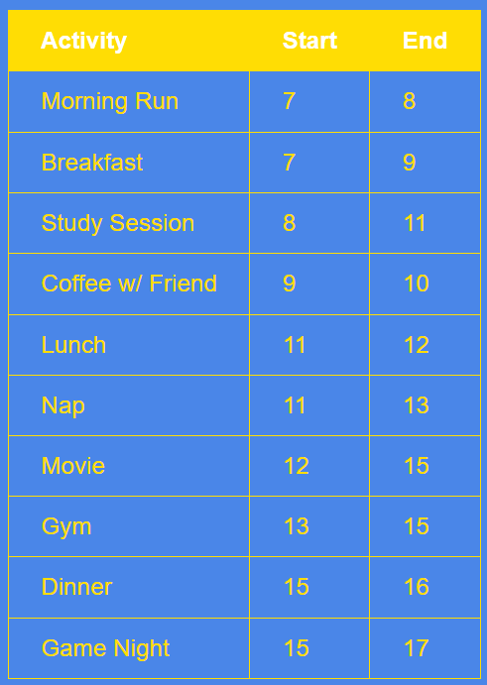
ACTIVITY CHALLENGE!
To the left is a list of your favorite activities. You can only do one activity at a time.
Decide on a greedy strategy for choosing activities and try to fit as many as possible into one day.
Write down your strategy and the list of activities that you can do by following the strategy.
Pick the activity that ends the earliest: Morning Run → Coffee w/ Friend → Lunch → Movie → Dinner
Notes:
The slide highlights the optimal strategy:
Always pick the activity that finishes the earliest
Why this works:
Finishing early leaves more room for future activities
This locally optimal choice leads to a globally optimal solution
🔹 Step-by-Step Strategy
Sort activities by end time (ascending)
Pick the first activity (earliest finish)
For the remaining:
Choose the next activity whose start time ≥ last selected activity’s end time
Repeat until no more activities can be added
Selection Process:
✅ Morning Run (7–8) → ends earliest
✅ Coffee w/ Friend (9–10) → next compatible
✅ Lunch (11–12)
✅ Movie (12–15)
✅ Dinner (15–16)
Why not Gym over Movie
🔹 Key Greedy Rule
Pick the activity that finishes the earliest
Both Movie and Gym:
End at 15
So at first glance, they seem equally good
🔹 So why choose Movie?
✅ Reason 1: Movie starts earlier (12 vs 13)
Movie uses time 12–13, which would otherwise be wasted
Gym leaves a gap (12–13) unused
👉 Greedy prefers:
Earliest finish → AND earliest start if tie
✅ Reason 2: Maximizing utilization
Movie fills the schedule more tightly
Gym introduces idle time

Slide 26
An attempted solution at any stage.
What is a configuration?

Slide 27
This represents one of the next possible choices.
What is a successor?

Slide 28
This programming technique is commonly used to implement backtracking algorithms.
What is recursion?

Slide 29
An optimization technique of abandoning a branch that is invalid.
What is pruning?
Notes:
Concept
You have a 3 × 7 container, so the total space is:
$3×7=21$squares
You must fill it using:
2 large boxes of size 2 × 3 → area $2×3=6$each, so total 12
4 medium boxes of size 1 × 2 → area $2$each, so total 8
1 small box of size 1 × 1 → area 1
Total box area:
$12+8+1=21$
So the pieces fit exactly into the container with no extra space.
Purpose of the slide
The purpose is to make students think about:
Constraint-based problem solving
Spatial reasoning
Greedy strategy
Why a strategy like place the largest pieces first can be useful
The difference between a heuristic and a guaranteed optimal algorithm
It is also a nice bridge into topics like:
greedy algorithms
bin packing
tiling problems
backtracking
Main idea being taught
A reasonable strategy is:
Place the largest boxes first
Then place the medium boxes
Use the small box to fill the final leftover gap

Slide 30
ACTIVITY CHALLENGE!
Pack a 3' by 7' container with the following boxes:
2 large boxes (2'x3')
4 medium boxes (1'x2')
1 small box (1'x1')
Y | Y | Y | Y | R | R | R
R | R | R | O | R | R | R
R | R | R | Y | Y | Y | Y
Y | Y
Y | Y
O
Y | Y
Y | Y
R | R | R
R | R | R
R | R | R
R | R | R
Worksheet: http://bit.ly/41HQyXr

Slide 31
This is an instance of a class.
What is an object?

Slide 32
The concept that state and behavior are bundled together and hidden from the user of a class.
What is encapsulation?

Slide 33
This Object Oriented Programming concept models an “is‑a” relationship between classes.
What is inheritance?

Slide 34
This technique converts an input value into a numeric value to enable fast comparisons and lookup.
What is hashing?

Slide 35
CODING CHALLENGE!
Write a method that given a list of strings
Returns a copy of the list with duplicates removed.
The strings must remain in their original order
Must run in O(n)
public static List<String> uniqueList(List<String> strings) {
HashSet<String> stringSet = new HashSet<>();
List<String> uniqueStrings = new ArrayList<>();
for (String string : strings) {
if (!stringSet.contains(string)) {
uniqueStrings.add(string);
stringSet.add(string);
}
}
return uniqueStrings;
}

Slide 36
This is data accessed by more than one thread.
What is a shared resource?

Slide 37
This is used to ensure only one thread enters a critical region at a time.
What is a lock?

Slide 38
These two actions release a lock held by a thread.
What are unlock and await?

Slide 39
CODING CHALLENGE!
Create a class named LetterAdder
Define a constructor that accepts a Map<Character,Integer> and Lock
Define a run() method named that does the following:
For all letters 'A' - 'Z'
If the letter is not in the map, add it with a value of 1.
Otherwise, increase the count by 1
After adding each letter, pauses for 100ms
Define a main method that:
Starts 10 LetterAdder threads
After all threads have finished, prints the Map
All letters should have a count of 10

Slide 40
public class LetterAdder {
private final Map<Character,Integer> letterCounts;
private final Lock lock;
public LetterAdder(Map<Character,Integer> letterCounts,Lock lock) {
this.letterCounts = letterCounts;
this.lock = lock;
}
public void run() {
for (char c = 'A'; c <= 'Z'; c++) {
try {
lock.lock();
if (!letterCounts.containsKey(c))
letterCounts.put(c,0);
letterCounts.put(c,letterCounts.get(c)+1);
} finally {
lock.unlock();
}
try { Thread.sleep(100); } catch (InterruptedException e) {}
}
}
public static void main(String[] args) throws InterruptedException {
Map<Character, Integer> letterCounts = new HashMap<>();
Lock lock = new ReentrantLock();
ExecutorService execSvc = Executors.newCachedThreadPool();
for (int i = 0; i < 10; i++) {
LetterAdder adder = new LetterAdder(letterCounts, lock);
execSvc.execute(adder::run);
}
execSvc.shutdown();
execSvc.awaitTermination(5, TimeUnit.SECONDS);
System.out.println(letterCounts);
}
}

Slide 41
CODING CHALLENGE!
Download http://holly.cs.rit.edu:20001/dragonball.zip
The cannon fires fireballs of various colors.
Only dragons of the same color can catch a fireball of their color.
As long as the cannon is not empty
Each dragon will wait until they see the cannon is ready to fire a fireball of their color (Dragons can "peek" at the cannon)
When a dragon sees that the cannon will fire their color, they will stop waiting, the cannon will fire, and they will catch the fireball.
Additional instructions in the zip file.

Slide 42
public class Dragon implements Runnable {
private final Cannon cannon;
private final Color color;
private final Lock cannonLock;
private final Condition colorCondition;
public Dragon(Color color, Cannon cannon, Lock cannonLock, Condition colorCondition) {
this.cannon = cannon;
this.color = color;
this.cannonLock = cannonLock;
this.colorCondition = colorCondition;
}
@Override
public void run() {
try {
while (true) {
cannonLock.lock();
while (!cannon.isEmpty() && cannon.peek() != color) {
try {
System.out.println(this + " waits for " + color + " fireball...");
colorCondition.await();
} catch (InterruptedException e) { e.printStackTrace(); }
}
colorCondition.signalAll();
if (cannon.isEmpty())
break;
System.out.println(this + " catches " + cannon.fire() + " fireball!");
colorCondition.signalAll();
cannonLock.unlock();
}
} finally {
cannonLock.unlock();
}
}
@Override
public String toString() {
return color + " Dragon";
}
}
public class Main {
public static void main(String[] args) {
final int NUMBER_OF_FIREBALLS = 20;
Cannon cannon = new Cannon(NUMBER_OF_FIREBALLS);
Lock cannonLock = new ReentrantLock();
Condition colorCondition = cannonLock.newCondition();
for (Color color : Color.values()) {
Thread dragon = new Thread(new Dragon(color, cannon, cannonLock, colorCondition));
dragon.start();
}
}
}

Slide 43
Vertices connected by at least one path are in the same one of these.
What is a connected component?

Slide 44
This path-finding algorithm is implemented with a queue and a map.
What is Breadth First Path?

Slide 45
This can cause a graph search to revisit the same vertices repeatedly.
What is a cycle?

Slide 46
ACTIVITY CHALLENGE!
Find the path from A to F in graph below using a Depth First Search. Visit neighbors in alphabetic order.
B
A
Visited
A
A
B
E
C
D
G
F
E
C
D
D
C
E
G
B
F
G
F

Slide 47
ACTIVITY CHALLENGE!
Find the path from A to F in graph below using a Breadth First Search. Visit neighbors in alphabetic order.
Vertex | Predecessor
B
A
A
Null
B
A
D
A
/
/
E
C
G
F
A
B
D
/
/
/
/
E
C
D
E
B
C
D
A B E F
Path (A to F)
F
G
G
D
F
E
47

Slide 48
This describes the best possible overall solution to a problem.
What is the global optimum?

Slide 49
This greedy path‑finding strategy always picks the lowest‑cost outgoing edge.
What is nearest neighbor?

Slide 50
In Djikstra's algorithm, this data structure replaces a priority queue to deal with path distance updates.
What is a tuple queue?

Slide 51
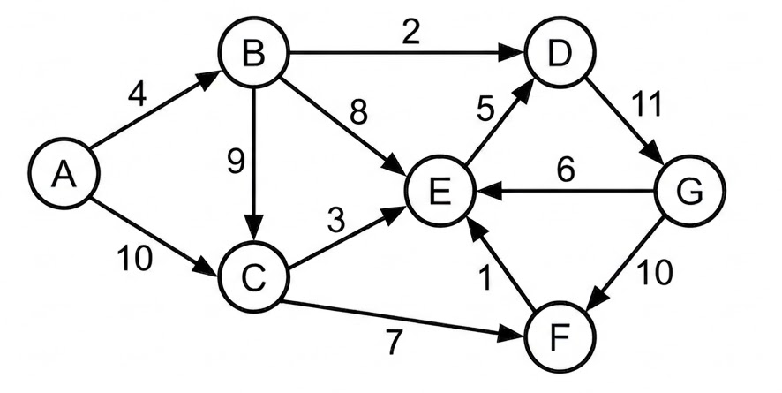
ACTIVITY CHALLENGE!
Using the Nearest Neighbor algorithm, find the path and total distance from A to F
A
B
D
G
/
E
F
4
2
11
/
6
10
27

Slide 52
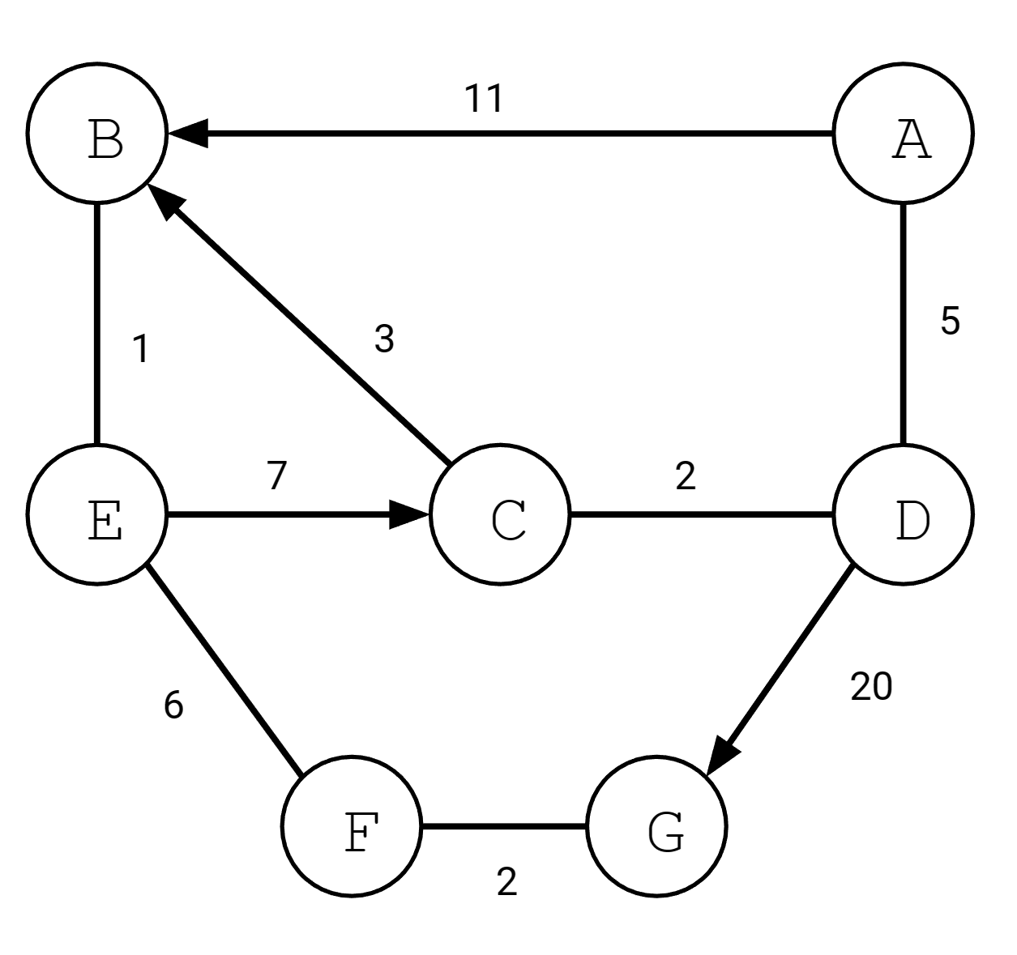
ACTIVITY CHALLENGE!
Find the path and distance from A to G using Dijkstra's algorithm
Iteration | Finalized Vertex | A | B | C | D | E | F | G
0 |  | 0,null | ∞,null | ∞,null | ∞,null | ∞,null | ∞,null | ∞,null
1
2
3
4
5
6
7
A
✔
11,A
∞,null
5, A
∞,null
∞,null
∞,null
D
11,A
7,D
✔
∞,null
∞,null
25,D
C
10,C
✔
∞,null
∞,null
25,D
B
✔
11,B
∞,null
25,D
E
✔
17,E
25,D
F
✔
19,F
G
✔
Worksheet: https://bit.ly/4ewGkAB

Slide 53
Backtracking relies on this data structure’s last‑in, first‑out behavior.
What is a stack?

Slide 54
These two configurations determine if the algorithm has reached a complete solution.
What are valid and goal configurations?

Slide 55
This operation avoids making changes to a single shared state.
What is a deep copy?

Slide 56
ACTIVITY CHALLENGE!
Consider a maze represented as 2D character array. Walls are represented by # and paths are represented by a space. Arrive at a backtracking solution that would allow you to find a path from S to E.
##########
S # # #
# # # # ##
# # ##
### ### ##
# # #
# ### ## #
# # # #
# # ## #
########E#
List the fields that would be included in the state of your Configuration?
How would you create successor configurations?
What would be a good pruning strategy?
How would you know that a Configuration is the goal?
2D character array, current row and column.
Make a deep copy of the array, mark the current row and column as a wall, create 4 successors - 1 for each move direction.
Prune successors where row and column is out of bounds or is a wall.
The successor is valid and the row and col is E.
Notes:
Here is a clean backtracking solution for the maze problem.
Idea
Treat each position in the maze as a configuration:
the maze grid
the current row
the current column
From each position, try moving:
up
down
left
right
If a move is invalid, prune it. If a move reaches E, you found the solution. To avoid cycles, mark visited cells.
Configuration state
A configuration should store:
char[][] maze
int row
int col
Optionally:
a reference to the parent configuration if you want to reconstruct the path
Successor generation
From (row, col) create up to 4 successors:
(row - 1, col) → up
(row + 1, col) → down
(row, col - 1) → left
(row, col + 1) → right
For each successor:
make a copy of the maze
mark the current position as visited, often by changing it to # or .
Pruning strategy
Reject a successor if:
row or column is out of bounds
the cell is a wall #
the cell was already visited
This prevents infinite loops and useless exploration.
Goal test
A configuration is the goal if:
maze[row][col] == 'E'

Slide 57
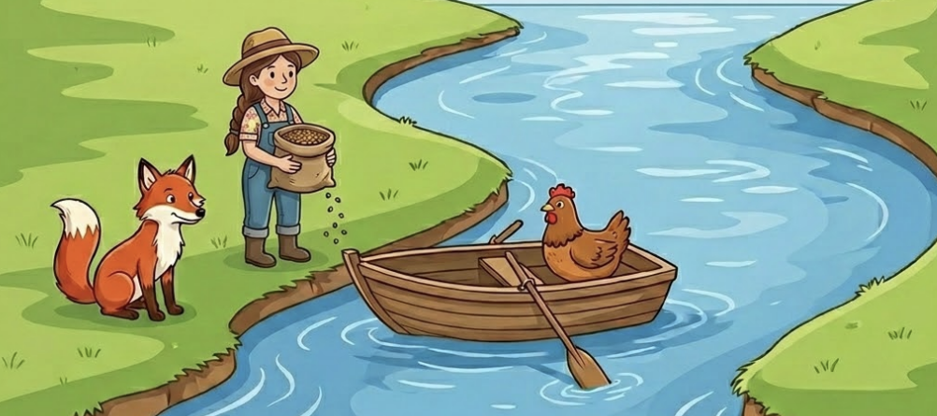
ACTIVITY CHALLENGE!
A farmer has a hen, a fox, and seed. She is one side of a river and needs to get all 3 cargo items across. But, she can only take 1 at a time in the boat. She can't leave the fox and hen together on the same shore alone, and likewise, cannot leave the hen and seed on the same shore alone. The farmer can cross the river alone. Think about how you would solve this problem using backtracking.
List the fields that would be included in the state of your Configuration?
How would you create successor configurations?
What would be a good pruning strategy?
How would you know that a Configuration is the goal?
Collections for starting shore, the destination shore, and "seen" configurations (to avoid cycles).
Make a deep copy of each shore collection, create a successor for each cargo item on the same shore as the farmer by moving the cargo item and farmer to the opposite shore. Also create a configuration for the farmer crossing alone.
Prune if the configuration has been "seen" before or fox/hen or hen/seed are on the same shore alone.
The farmer and all cargo items are on the destination shore.
Notes:
A valid solution is:
Take the hen across
Farmer comes back alone
Take the fox across
Bring the hen back
Take the seed across
Farmer comes back alone
Take the hen across
State sequence
Using:
L = left shore
R = right shore
Format: (Farmer, Fox, Hen, Seed)
Start:
(L, L, L, L)
After hen across:
(R, L, R, L)
Farmer back alone:
(L, L, R, L)
Fox across:
(R, R, R, L)
Hen back:
(L, R, L, L)
Seed across:
(R, R, L, R)
Farmer back alone:
(L, R, L, R)
Hen across:
(R, R, R, R)
Goal
Reached when:
Farmer, fox, hen, and seed are all on the destination shore
Backtracking view
This is a backtracking problem because:
At each state, you try a legal move
You reject states where:
fox and hen are left alone
hen and seed are left alone
or the state was already seen
So the successful path is:
Hen → Back alone → Fox → Hen back → Seed → Back alone → Hen
I can also format this as a classroom-ready table or pseudocode.

Slide 58
This Java type is used to define an Abstract Data Type (ADT).
What is an interface?

Slide 59
This provides a concise way to represent a single‑method class as an expression.
What is a lambda?

Slide 60
An intermediate stream operation produces a new stream of transformed elements.
What is map()?

Slide 61
CODING CHALLENGE!
Create a class named Swapper. The main method should open the word_pairs.txt data file, swap the words on each line, and print the swapped word lines in alphabetical order. Your solution must use only stream methods and use at least 4 stream methods.
public static void main(String[] args) throws IOException {
String file = "data/word_pairs.txt";
try (FileReader fr = new FileReader(file);
BufferedReader br = new BufferedReader(fr)) {
br.lines()
.map(line -> line.split(" "))
.map(parts -> parts[0] + " " + parts[1])
.sorted()
.forEach(System.out::println);
}
}

Slide 62
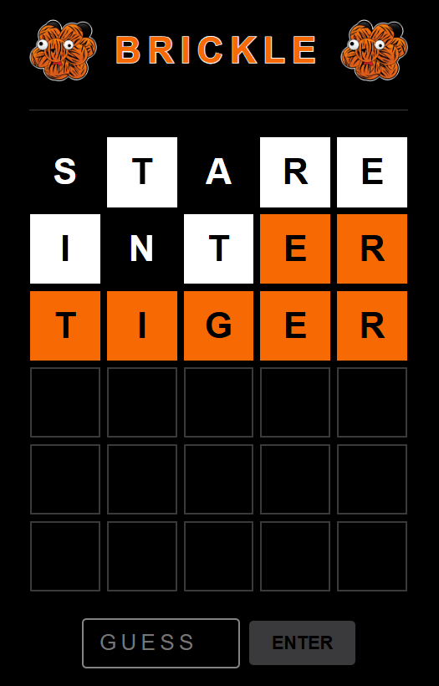
CODING CHALLENGE!
Download http://holly.cs.rit.edu:2001/brickle.zip
Implement BrickleHandler to play a game of Brickle¹
Test with brickle.html
Request Method and URI | Request Body | Response Body
GET /gamestate | N/A | IN_PROGRESS WON LOST
GET /guessesleft | N/A | <guesses left>
POST /guess | <guess> | <feedback>
¹Totally not a rip-off of an online word game

Slide 63
public class BrickleHandler implements RequestHandler {
private Brickle game;
public BrickleHandler() {
this.game = new Brickle("TIGER");
}
private boolean isRoute(HttpRequest request,HttpRequest.Method method,String uri) {
return request.getMethod() == method && request.getUri().equals(uri);
}
@Override
public String handleRequest(HttpRequest request) {
if (isRoute(request,HttpRequest.Method.GET,"/gamestate"))
return game.getGameState().toString();
else if (isRoute(request,HttpRequest.Method.GET,"/guessesleft"))
return Integer.toString(game.getGuessesLeft());
else if (isRoute(request,HttpRequest.Method.POST,"/guess")) {
String guess = request.getBody();
try {
return game.guess(guess);
} catch (IllegalStateException | IllegalArgumentException e) {
return "ERROR: " + e.getMessage();
}
}
return null;
}
}

